Slide 1


App Design
By Kristina Dunai

Slide 2
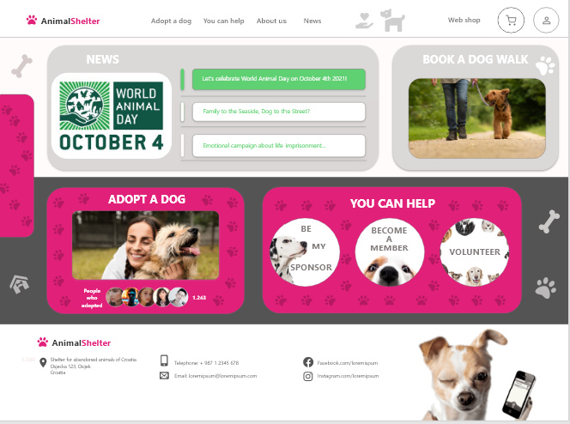
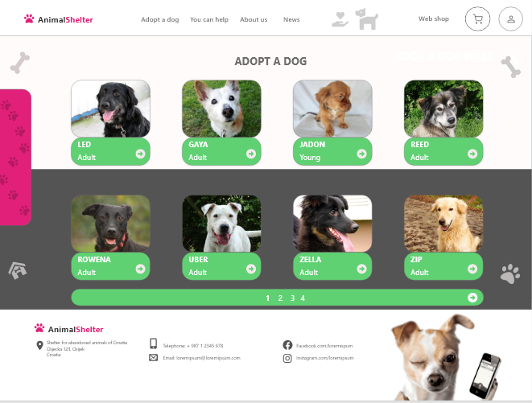
Project overview
The product:
AnimalShelter is completely adequate for housing and care of abandoned dogs in. All dogs that are ready for adoption in the shelter have been vaccinated against rabies and all common infectious diseases, microchipped, and the adults have also been spayed or neutered. AnimalShelter’s targets people who wants to donate to the shelter with buying products, but are too busy to visit shelter.
Project duration:
October 2021

Slide 3
Project overview
The problem:
Busy dog lovers lack the time to visit the shelter to see dogs for adoption.
The goal:
Design an web site for AnimalShelter that allows users to easily find a dog for walk, adoption, to became sponsor, volunteer etc.

Slide 4
Project overview
My role:
UX designer designing an web site for Animal Shelter from conception to delivery.
Responsibilities:
Conducting interviews, paper and digital wireframing, low and high-fidelity prototyping, conducting usability studies, accounting for accessibility, and iterating on designs.

Slide 5
User research
Personas
Problem statements
User journey maps
Understanding
the user

Slide 6
User research: summary
I conducted interviews and created empathy maps to understand the users I'm designing for and their needs. A primary user group identified through research was who wants to buy and thus donate money to the shelter.
In addition to sales, in order to promote the shelter, respondents showed interest in monitoring animals, adoptions, volunteers, donors, etc.

Slide 7
User research: pain points
1
2
3
Time
Accessibility
IA
Working adults and students are too busy to visit the shelters.
There are no platforms for sales and for review the work in the shelters
Easy-to-use intuitive software to help shelters streamline oprations like monitoring animals in shelters, volunteers, donors, licecing.

Slide 8
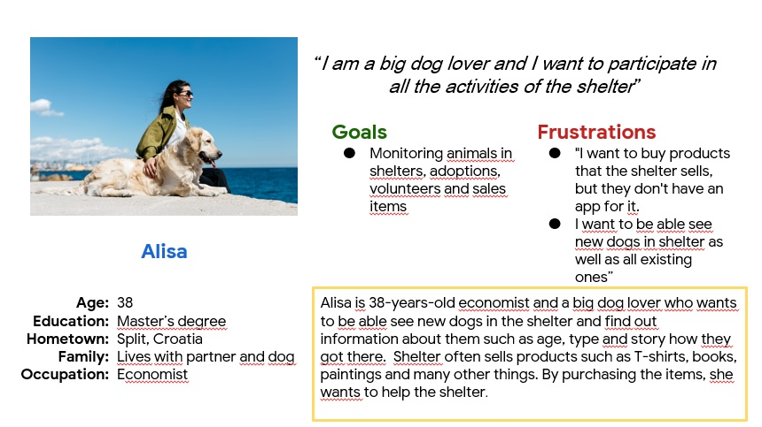
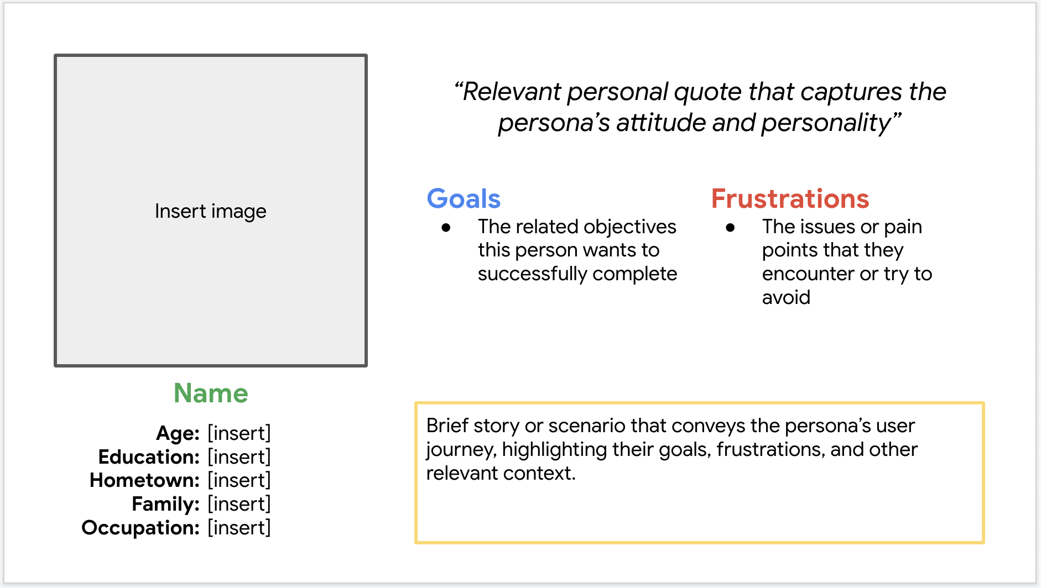
Persona: Alisa
Problem statement:
Alisa is a busy dog lover who needs an app for purchasing items from shelter because that way she can donate to shelter.

Slide 9
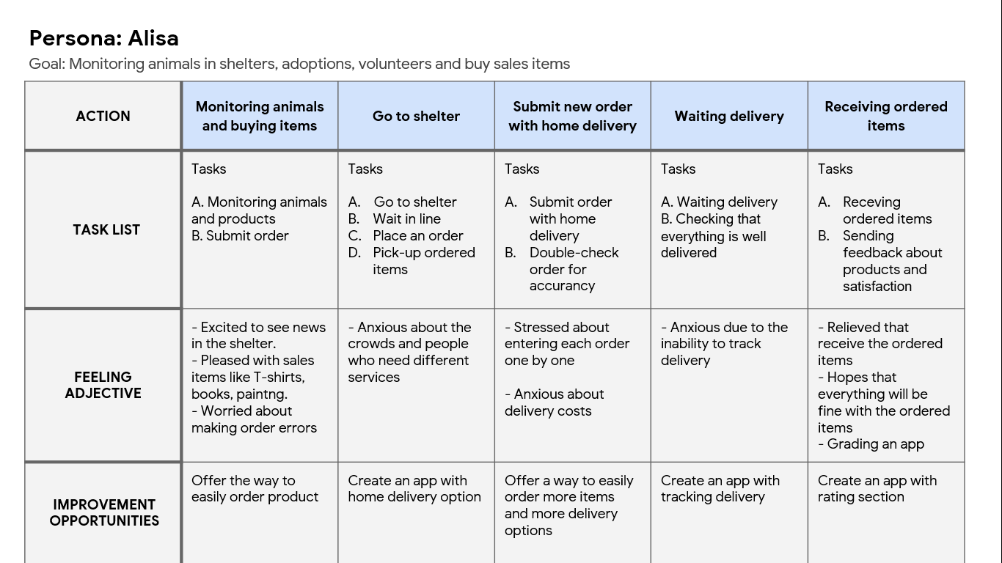
User journey map
Mapping Alisa’s user journey revealed how helpful it would be for users to have access to a dedicated AnimalShelter’s web site.
Image of user journey map

Slide 10
Paper wireframes
Digital wireframes
Low-fidelity prototype
Usability studies
Starting
the design

Slide 11
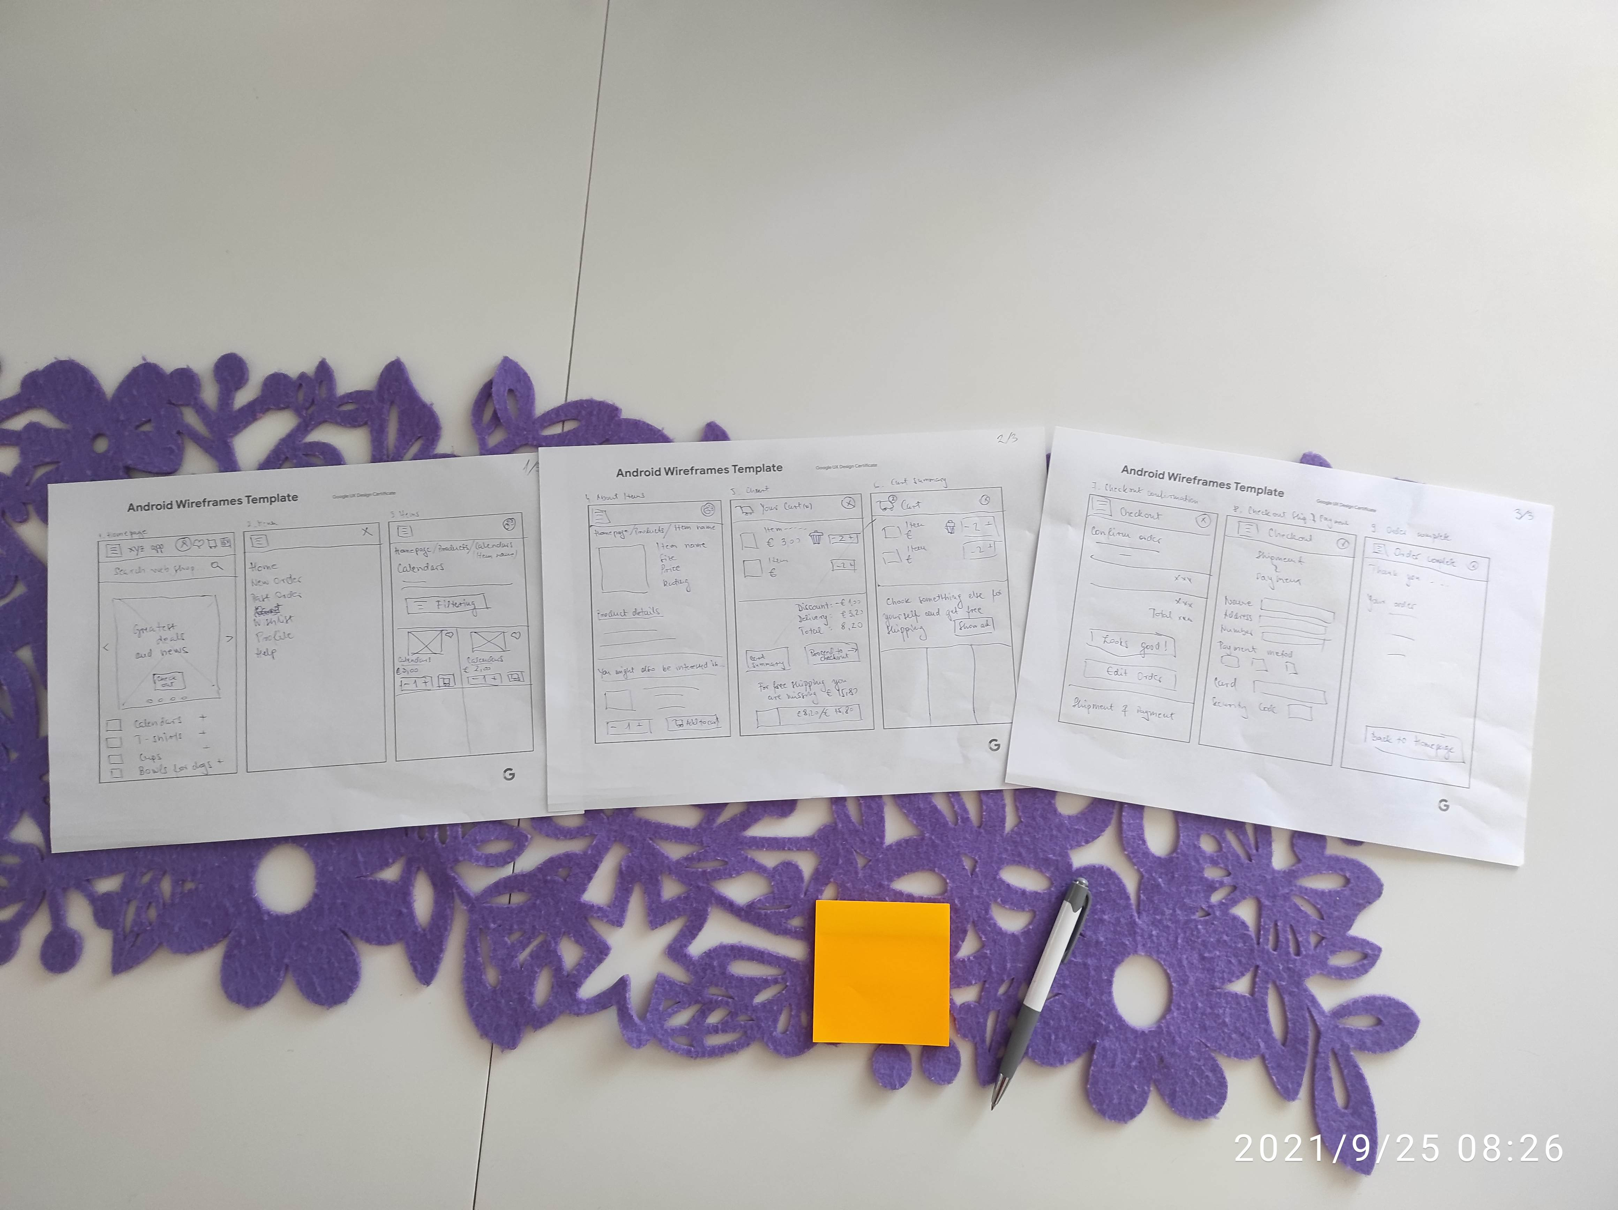
Paper wireframes
Taking the time to draft iterations of each screen of the app on paper ensured that the elements that made it to digital wireframes would be well-suited to address user pain points. For the home screen, I prioritized a quick and easy ordering process to help users save time.

Slide 12
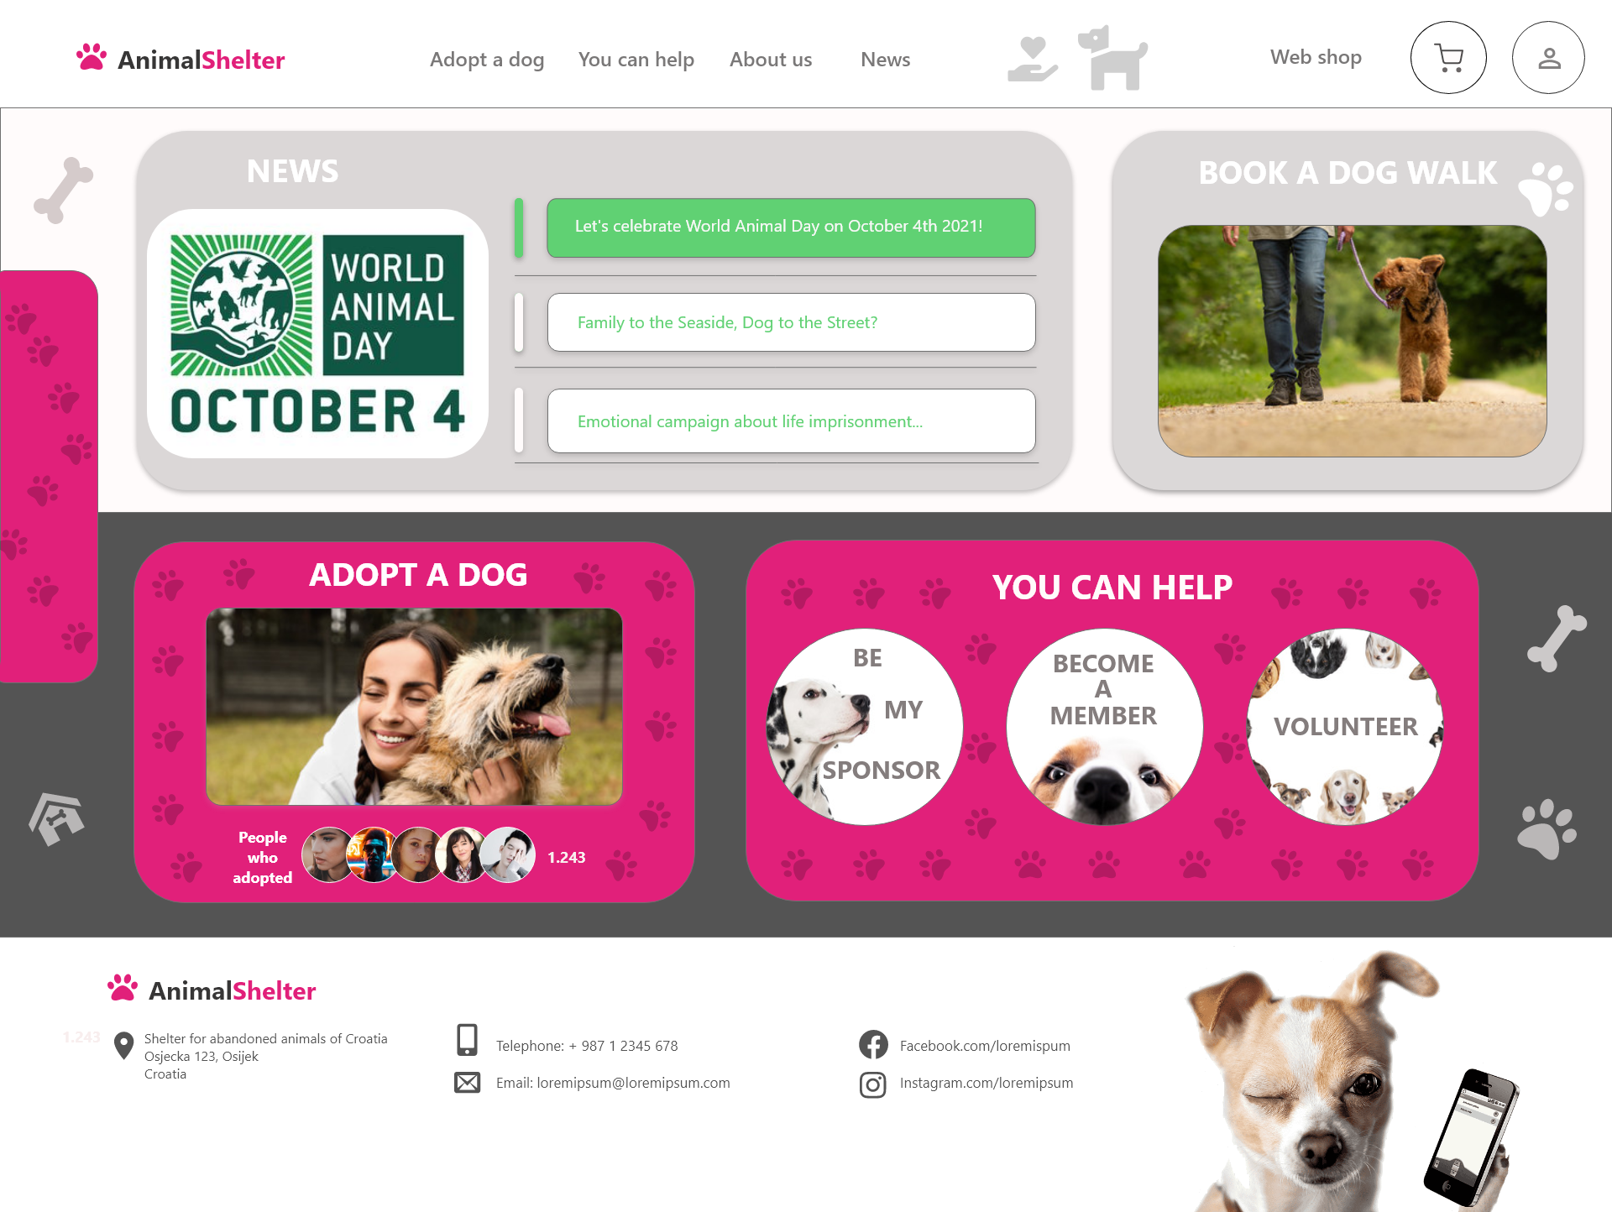
Digital wireframes
As the initial design phase continued, I made sure to base screen designs on feedback and findings from the user research.

Slide 13
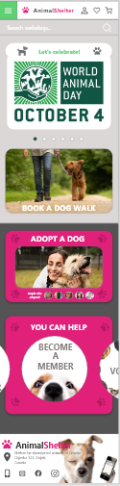
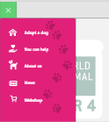
Digital wireframes
Easy navigation was a key user need to address in the designs in addition to equipping the app to work with assistive technologies.

Slide 14
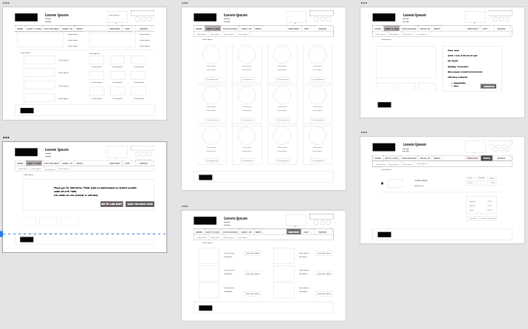
Low-fidelity prototype
Using the completed set of digital wireframes, I created a low-fidelity prototype. The primary user flow I connected adopting a dog, so the prototype could be used in a usability study.

Slide 15
Study Details
Research Questions
Participants
Methodology
How long does it take a user to find dog for adoption?
Are users able successfully review what they want?
What can we learn from the user flow, and what are the steps user take to find an informations that is looking?
Are there any parts of the web site where users are getting stuck?
5 participants
Two males, two females and one non-binary individual between the age of 20 to 65
Participants order at least once a month
15 minutes per participant
Croatia, remote
Unmoderated usability study
Users were asked to perform tasks in a low-fidelity prototype

Slide 16
Research insights
Fast ordering
Customization options
Recommendation
Saving past orders
Users need a way to order more quickly without having to go through the full build an order process
Users need better customization options when making the multiple order
Users need to see recommended items
Users need to see past orders to review them

Slide 17
Refining
the design
Mockups
High-fidelity prototype
Accessibility

Slide 18
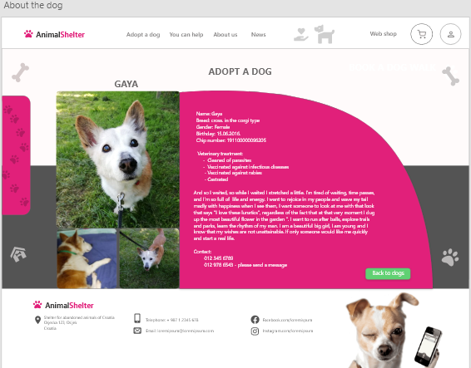
Mockups
Early designs didn’t have a separate page to describe each dog ready for adoption and fun facts.

Slide 19
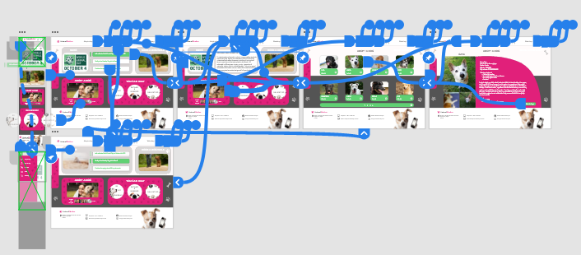
High-fidelity prototype

Slide 20
Accessibility considerations
1
2
3
Provided access to users who are vision impaired through adding alt text to images for screen readers.
Used icons to help make navigation easier.
Used detailed imagery for products to help all users better understand the designs.

Slide 21
Going forward
Takeaways
Next steps

Slide 22
Takeaways
Impact:
The web site makes users feel like AnimaShelter’s site really thinks about how to meet their needs.
One quote from peer feedback:
“The site made it so easy and fun to review dogs in shelter! I would definitely use this site.”
What I learned:
While designing the AnimaShelter’s web site, I learned that the first ideas for the site are only the beginning of the process. Usability studies and peer feedback influenced each iteration of the sites designs.

Slide 23
Next steps
1
2
Conduct another round of usability studies to validate whether the pain points users experienced have been effectively addressed.
Conduct more user research to determine any new areas of need.

Slide 24
Insert a few sentences summarizing the next steps you would take with this project and why. Feel free to organize next steps in a bullet point list.
Let’s connect!
Thank you for your time reviewing my work on the AnimalShelter web site! If you’d like to see more or get in touch, my contact information is provided below.
Email:
Website:

